Slide 1
The Dalles Dam Oil Spill Response Plan
Bob Cordie
Biologist
The Dalles Dam
May 2016 FPOM meeting

Slide 2
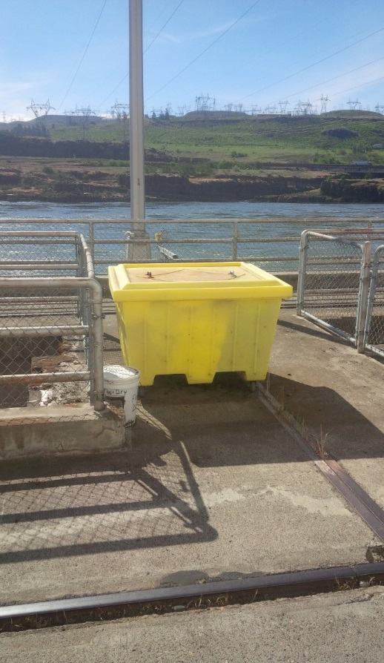
Spill Prevention, Control and Countermeasure Plan (SPCC)
Purpose; ‘to describe measures implemented by the The Dalles Dam to prevent oil discharges from occurring, and in the event of a discharge, prepare the facility to respond in a safe, effective, and timely manner’.
Covers; Oil storage, discharge potential, prevention measures, countermeasure response, equipment location, waste disposal, volumes, transfer requirements, training...

Slide 3
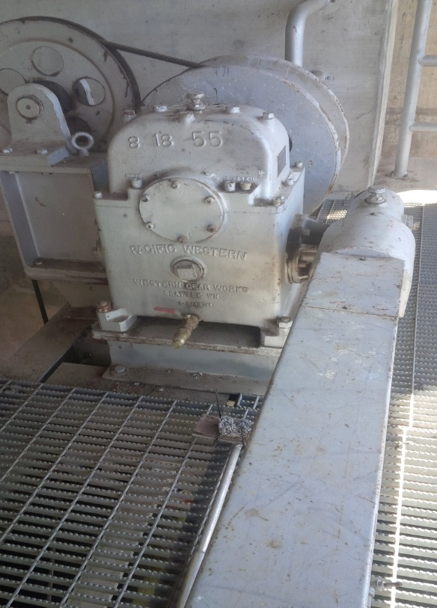
Oil Accountability Program
Includes;
Standing procedures
Oil/grease tracking and inventory
Valve locations
Oil applications
Training
Oil transfer
Equipment inspection program
Fisheries involvement on monthly inspections of spillway, sluiceway and fishway equipment for any leakage.

Slide 4
Spill Response Team
Members from several on site COE sections to respond to oil spill in river.
Planning and drills for deploying containment and deflection booms in river.
Countermeasures for both internal and external spills.
Apply WA Department of Ecology Geographic Response Plan (GRP) and work in conjunction with state and federal agencies.

Slide 5
Fishladder Exit Permanent Boom
24/7 protection from upriver oil spill
Purchased east fishway exit boom. Awaiting funding and opportunity after EFL AWS
Boom plan previously coordinated with FPOM

Slide 6
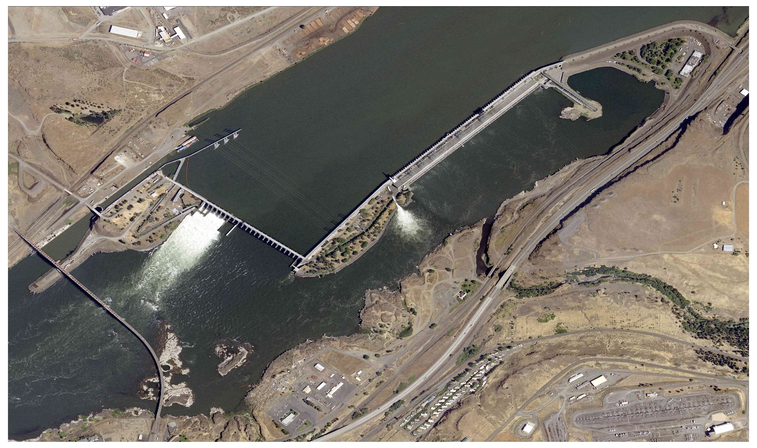
External Oil Spill Potential Response
Sluiceway closure (30 min) if needed. Powerhouse unit prioirity adjust (1 hr) as directed from unified command
East Fishway - Deploy absorbant boom inside permanent boom (2 hrs), close 159 weir (30 min), monitor, partial close bulkhead (2 – 8 hours) if needed, full close bulkhead if needed
North Fishway-Deploy boom PUD intake (3 hrs), monitor, partial close bulkhead (2-8 hrs), full close bulkhead if needed.
Spillway –Monitor entrainment, reduce or close spill (30 min) as directed by unified command

Slide 7
Intake Flow Elevations
Turbine Units – roof of intake el 134’
Forebay Avg el 158.5 - 159
East Fishladder - surface
Navlock Intake -surface
Sluiceway surface
North Fishladder and PUD - surface
Spillway crest el 121’

Slide 8
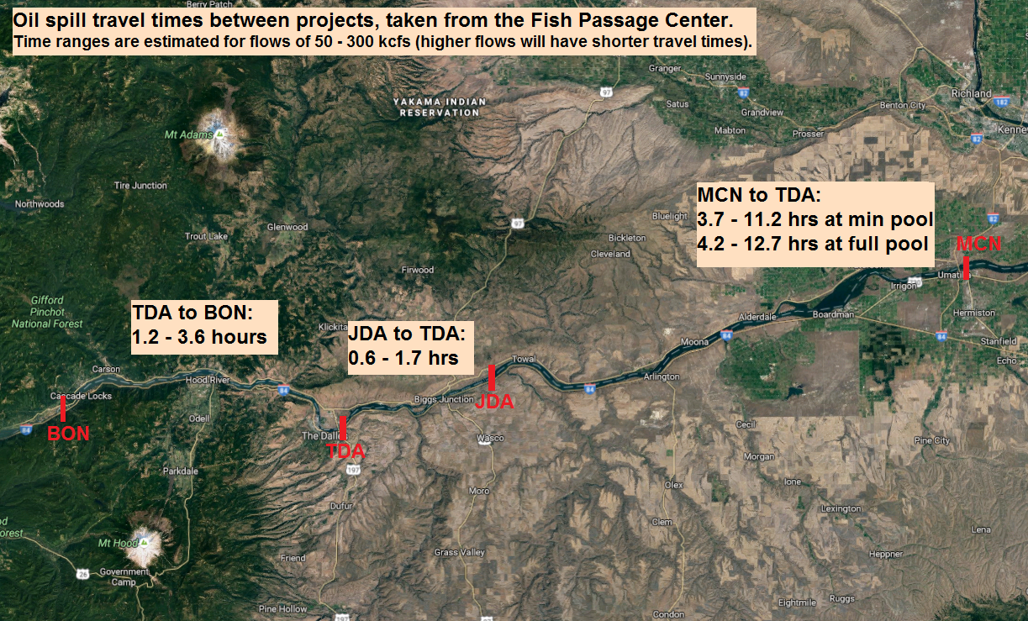
Pool Travel Time

